Slide 1
Object Tracking Using
SIFT Features in a
Particle Filter

Slide 2
Abstract
This paper adds sift matching features into the particle filter tracking framework base on color histogram feature, and proposes a dual character tracking algorithm, in which the particle weights are calculated considering both the sift matching features and the color histogram feature. Experimental results shows this approach is working better especially in cases that illumination changes.

Slide 3
Intro
Tracking target in video is important application of CV.
Color feature
Color histogram (Runs well when no changes on scene)
Fails on illumation etc.
What to do ? (Combine the color histogram features with SIFT)

Slide 4

What was SIFT?
SIFT: Scale Invariant Feature Transform
The algortihm is a multi-scale feature extraction algorithm based on gradient information. The core idea is extracting feature points in different scales of the image. It makes full use of scale space features and has good robustness of scale invariant.

Slide 5
The Algorithm
1) Detection of extreme-value points in scale space.Each sampling point is compared with all the adjacent points in image filed or scale field to see if its value is the biggest or the smallest.
2) Accurate determination of location of extreme-value points.We can accurately determine the key points’ location and scale by fitting a 3D quadratic function. Meanwhile remove the key points of low contrast and instable edge response point to enhance the matching stability and improve resistance to noise.
3) Determine the main direction of extreme-value points

Slide 6
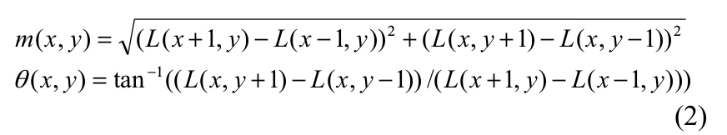
The Algorithm (Continue)
SIFT algorithm uses gradient direction's distribution characteristic of adjacent pixels of the key points to specify
direction parameters, as shown in (2).

Slide 7
The Algorithm (Continue)
4) Generate feature vectors.Calculating gradient histogram in 8 directions and plotting accumulated value of each gradient direction to form a seed point. 16 seed points are used to describe each feature point, and 128D feature vector is formed.
5) Match feature points.Euclidean distance between feature vectors is used asthe similarity measure of key points in two images.

Slide 8
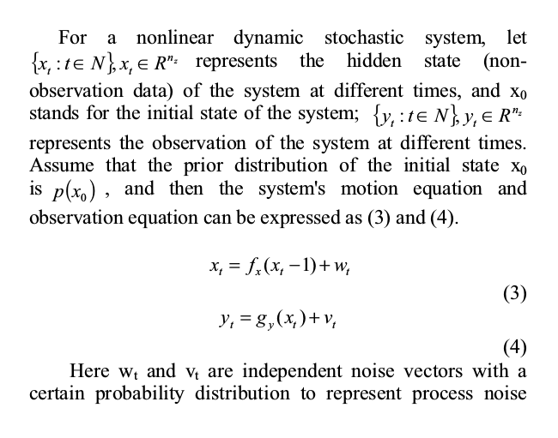
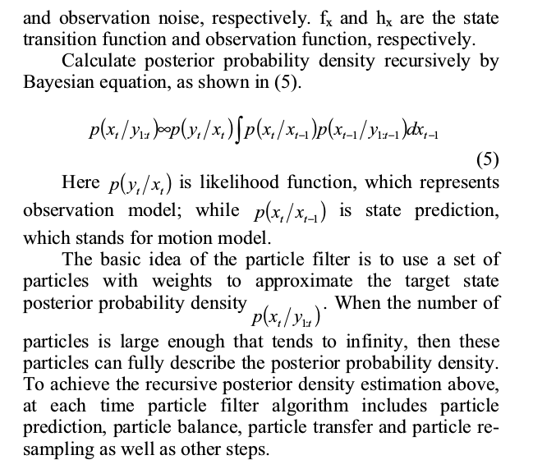
Particle Filter Principles

Slide 9
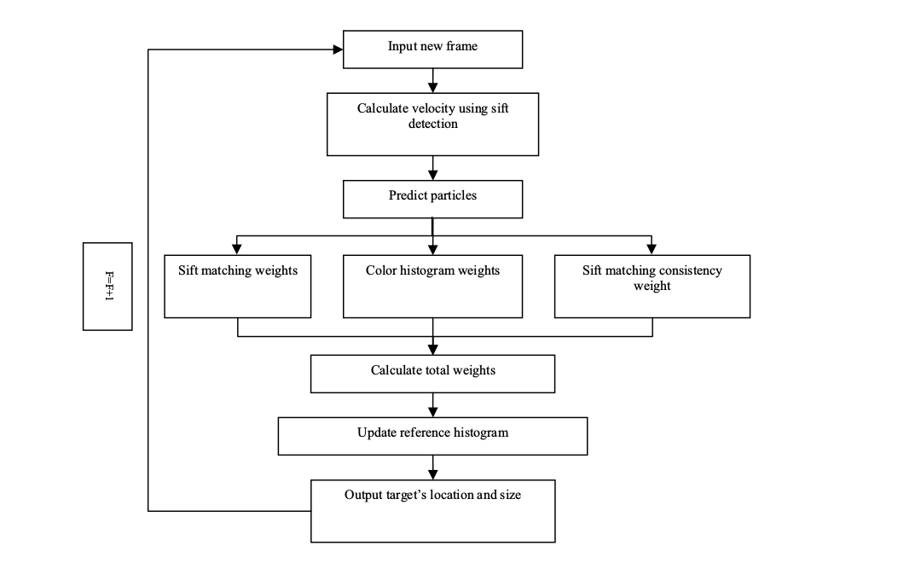

Slide 10
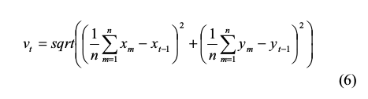
Calculate Velocity Using SIFT
Calculate the center coordinates of the best sift matching points between current frame and templates, and then calculate the Euclidean distance between the center coordinates and tracking results of the previous frame as target velocity. As shown in (6).

Slide 11
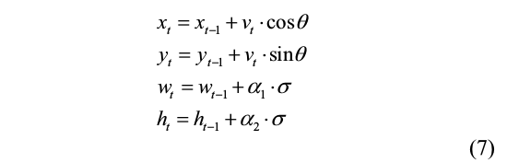
Predicting Particles
Particle state is defined as (x, y, w, h), which represent the center coordinates of particle, width and height, respectively. Predict particles in accordance with uniform distribution of random walk, as shown in (7).
Here v(t) is random velocity. Theta is the angle between prediction vector and the horizontal axis, generated equal-interval according to the number of particles. Sigma is uniformly distributed random noise, and alpha1, alpha2 is the variance of sigma.

Slide 12



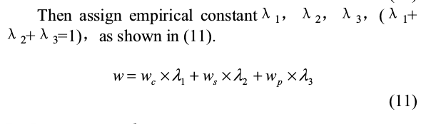
Calculating Particle Weights
(B is Bhattacharyya distance)

Slide 13
Remove Error Detection Points
1) Feature points corresponding to two or more points in the templates are removed.
2) Estimate the rotation angle between matching image and templates, the points with larger error are ignored.
3) Estimate the size scale between matching image and templates, the points with larger error are ignored.

Slide 14
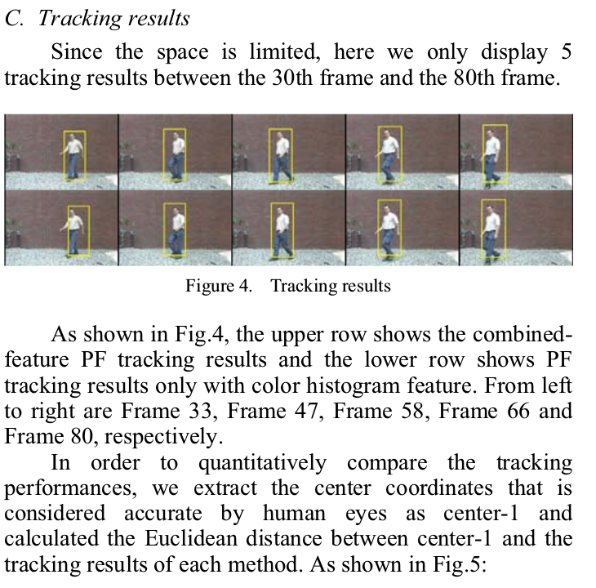
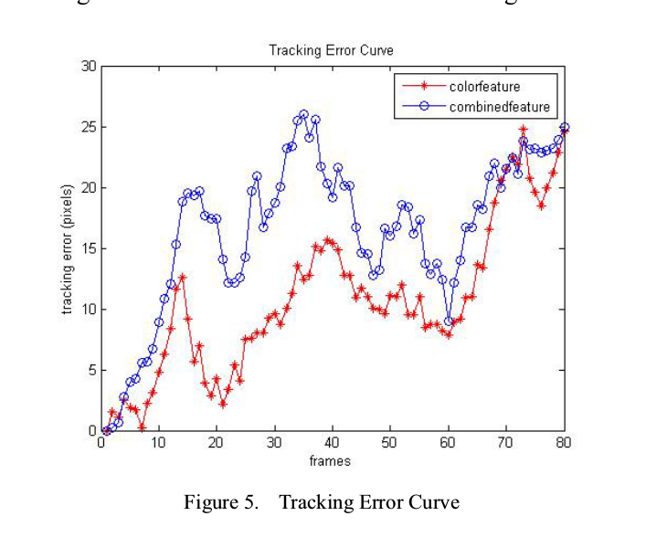
Results

